Slide 1

Tuckman Model of Team Development
Manny Dhesi Arfaz Hussain
01/15
Notes:
Arfaz / Manny

Slide 2

The Tuckman Model
Helps explain the five important stages of team development and growth
Considers the dynamics of team interactions and the impact of individual behavior on the overall team
Provides insight into team challenges, conflicts and how to navigate and build cohesion for high performance
Helps team understand the normalcy of conflict and to effectively work through it to achieve a high-performing team
[1]
02/15
Notes:
Arfaz / Manny

Slide 3

Stages of Team Development
FORMING
STAGE
STORMING
STAGE
NORMING
STAGE
PERFORMING STAGE
ADJOURNING STAGE
03/15
Notes:
Arfaz

Slide 4

FORMING STAGE
04/15
Notes:
Arfaz

Slide 5
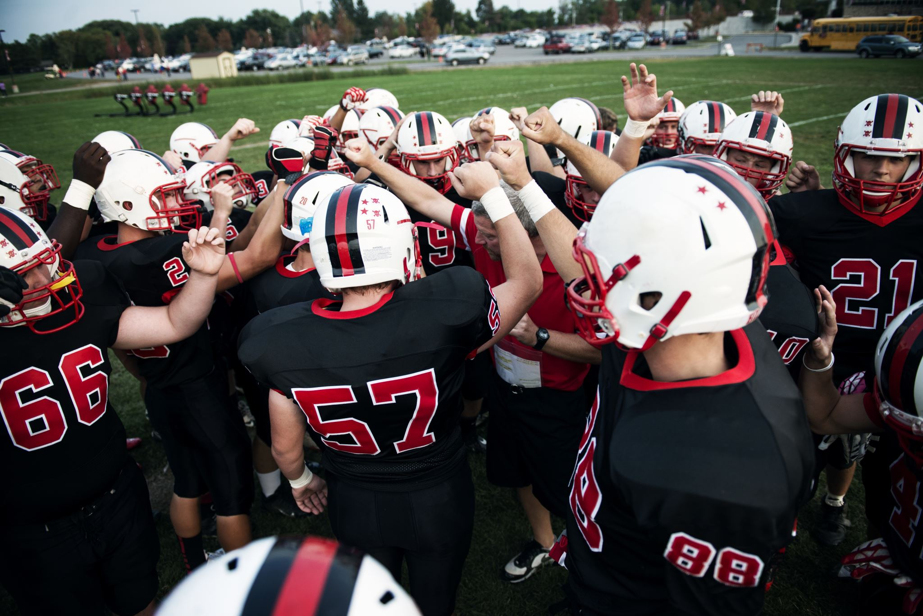
Forming Stages
Team members lack clarity what they are to do
The mission isn’t owned by the team
There is a lack of direction
Trust has not been established
No relationships exist within the team
The team has not established ‘the way they work’
No established commitment to the team
05/15
Notes:
Arfaz

Slide 6

STORMING STAGE
06/15
Notes:
Manny

Slide 7
Storming Stages
Roles and responsibilities are stated
Agendas are displayed
Problem solving doesn’t happen
People are anxious
There is a lot of competition between team members
There is a lack of team spirit
People try different ideas
Cliques and splinter groups form
07/15

Slide 8

NORMING STAGE
08/15
Notes:
Arfaz

Slide 9

Norming Stages
Trust has been established
Team members appreciate one another
There is clarity of purpose
Team members are confident
Creativity is displayed
Motivation is high
Everyone is committed to the team mission
09/15
Notes:
Arfaz

Slide 10

PERFORMING STAGE
10/15

Slide 11
Performing Stages
The team clearly understands the task at hand
Group is focused achieving goals of the project
Roles have been established for each member
Every member has involved themselves in some way
Strength and weaknesses are considered for each partner
11/15

Slide 12

ADJOURNING STAGE
12/15

Slide 13
Final stage of team development
Completion of the group project, task and teamwork
Feeling of loss among some team members
Reflection on everyone's participation and impact
Farewell, closure and reflection
Disbandment, end of journey
Opportunities for future growth and improvement
Adjourning Stages
13/15

Slide 14
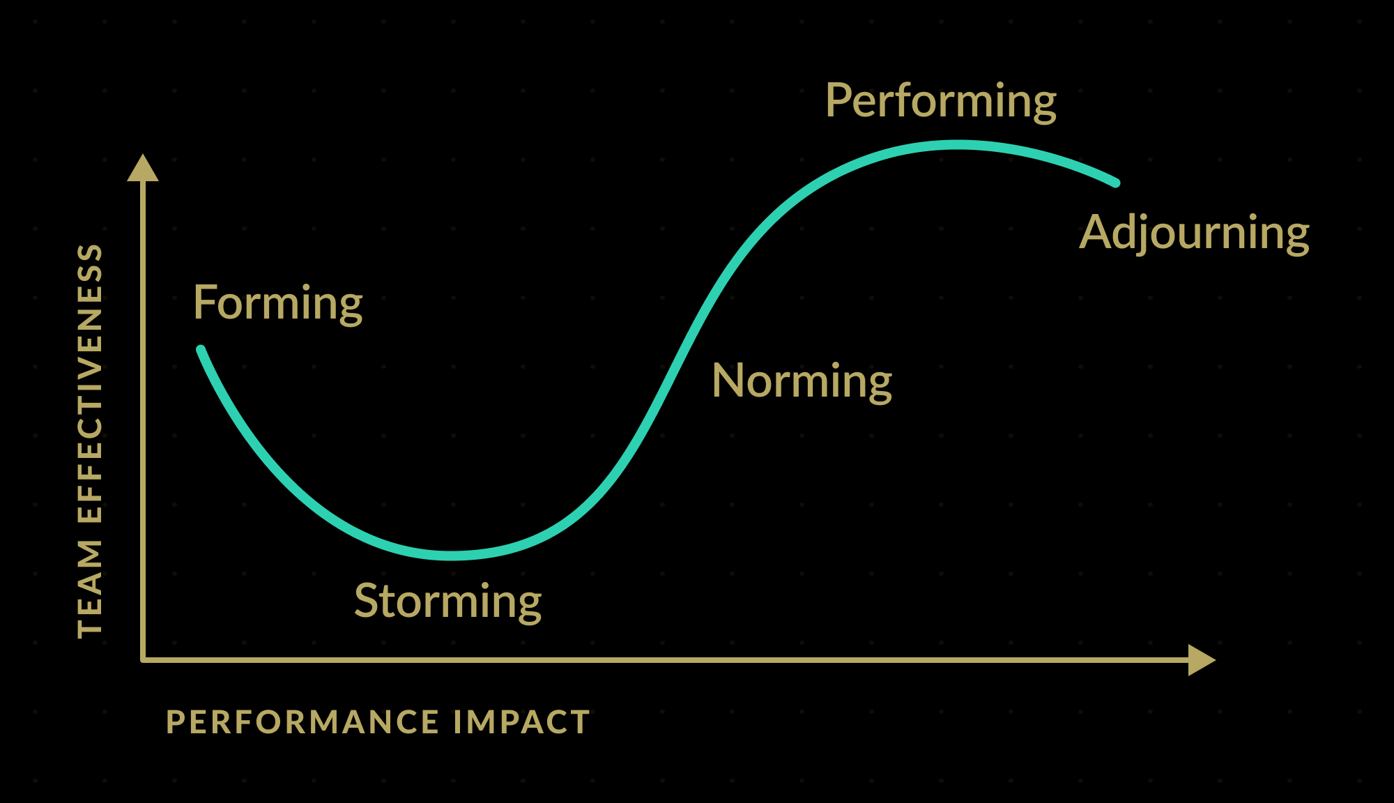
The Link Between Team Effectiveness and Performance Impact
Figure: The Correlation Between Team Effectiveness and Performance Impact
14/15
Notes:
Arfaz

Slide 15

References
[1] D. A. Bonebright, “40 years of storming: a historical review of Tuckman’s model of small group development,” Human resource development international, vol. 13, no. 1, pp. 111– 120, 2010, doi: 10.1080/13678861003589099
[2] D. Natvig and N. L. Stark, “A Project Team Analysis Using Tuckman’s Model of Small-Group Development,” The Journal of nursing education, vol. 55, no. 12, pp. 675–681, 2016, doi: 10.3928/01484834-20161114-03
[3] J. Stein, “Using the Stages of Team Development,” MIT, 2019. https://hr.mit.edu/learningtopics/teams/articles/stages- development
15/15

Slide 16
Questions?

